Slide 1
A cyberphysical world - Kick off Digital data Square Zuid nederland

Slide 2
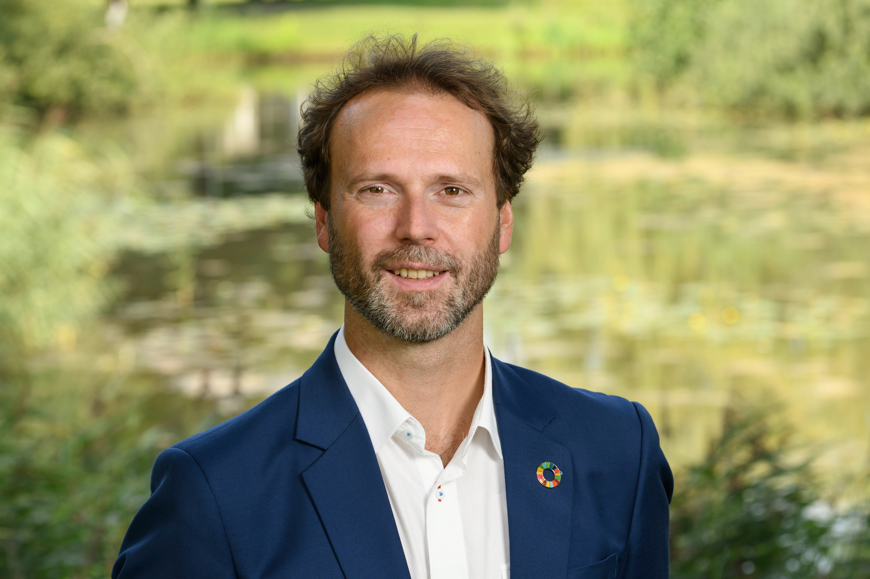
Dr. ing. Daniël Telgen, MSc CEO
Introduction
My mission
Help solve the ‘wicked problems’ in the world by using technology.
CEO Cboost
Engineering company
Adding intelligence to machines
Providing R&D teams for Robotics & AI solutions
Applied Professor Robotics & Sensoring
Purpose: Applied Research
Connecting education, industry and research

Slide 3
Mission statement
Drive the Change
to a sustainable & healthy world
with the help of (Cyber-physical) Technology

Slide 4
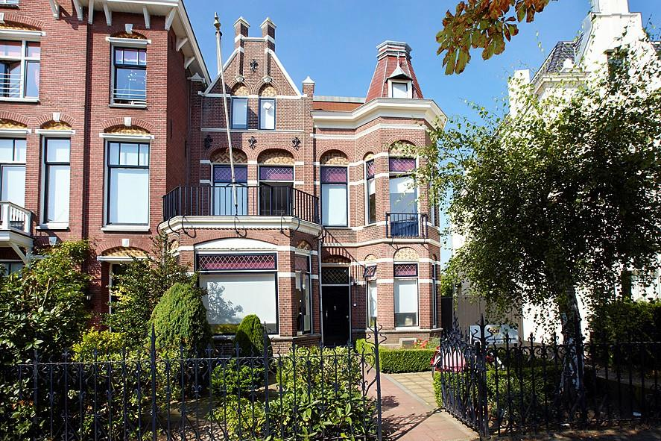
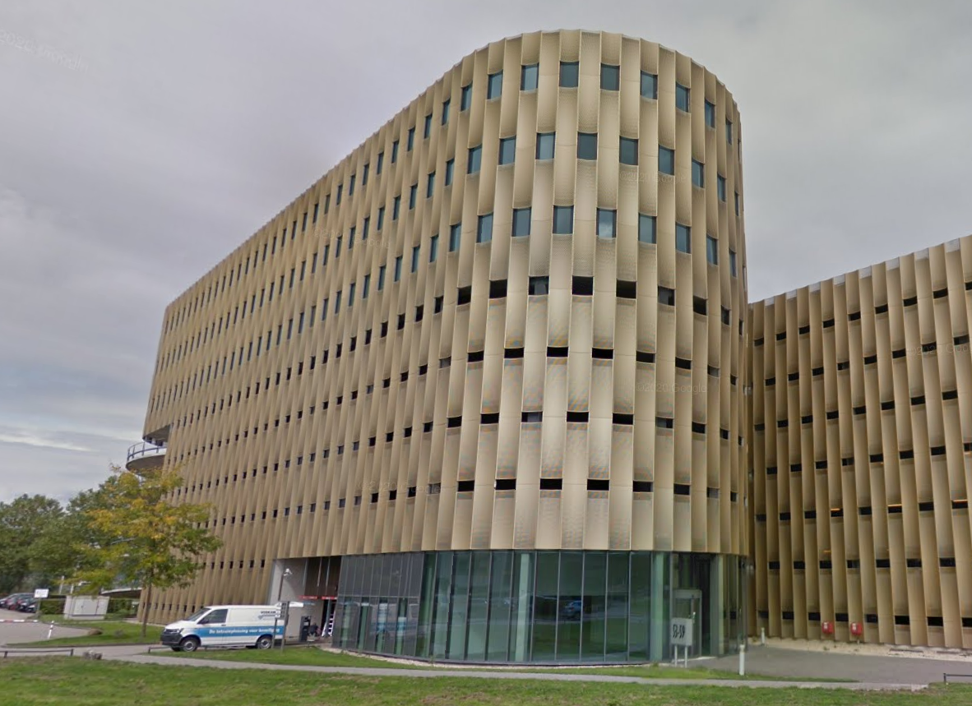
Cboost stats
Gestart in september 2020
3 Kantoren: Breda, Utrecht en Eindhoven (HTC)
15+ Cboosters -> planning 50 in 2023
Groot partnernetwerk
Driving innovation for a sustainable and a healthy world!
Bergen know-how in autonomous systems, robotics, AI -> cyberphysical systems

Slide 5
(R)Evolution: Society 5.0
Industry 5.0 Cognitive?
Industry 4.0 Cyber-Physical
We are here
Industry 3.0 Computer
Unknown future
Society 5.0 Holistic?
Industry 2.0 Electricity
Industry 1.0 Engine
Society 4.0 Information
1750
Society 3.0 Industrial
Society 2.0 Agrarian
Society 1.0 Hunting & Gathering
Prehistory

Slide 6
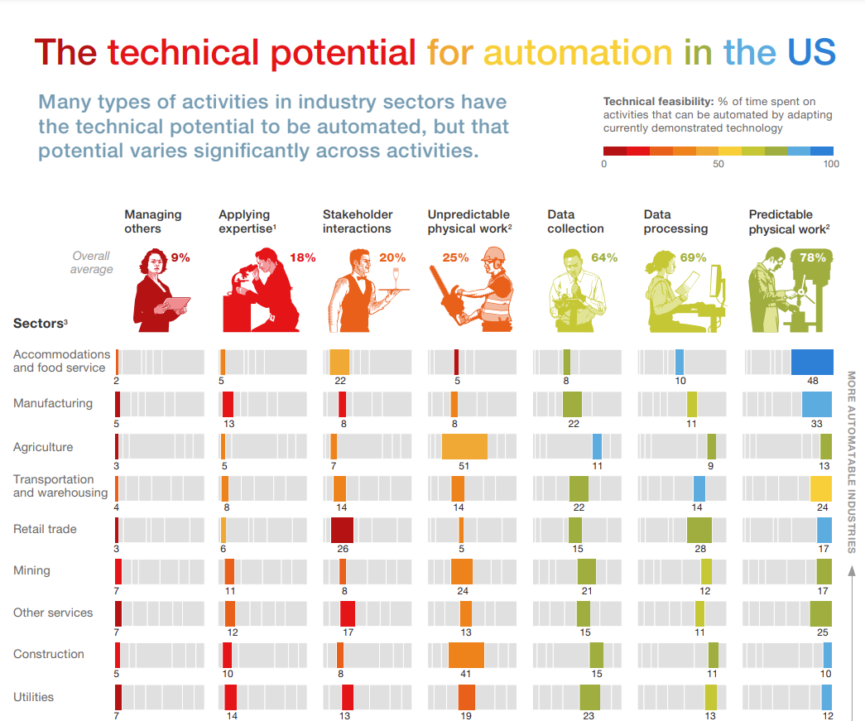
Welk werk is nu automatiseerbaar?
Logistieke sector (transport en warehousing) – getallen uit de V.S.
Type werk | % van het werk | Automatiseer-baar %
Managing others | 4% | 25%
Applying Expertise | 8% | 25%
Stakeholder interaction | 14% | 35%
Unpredictable Physical Work | 14% | 35%
Data Collection | 22% | 75%
Processing data | 14% | 85%
Predictable Physical Work | 24% | 55%
Bron: Mckinsey
Notes:
https://www.mckinsey.com/business-functions/mckinsey-digital/our-insights/where-machines-could-replace-humans-and-where-they-cant-yet
https://www.mckinsey.com/~/media/mckinsey/business%20functions/mckinsey%20digital/our%20insights/where%20machines%20could%20replace%20humans%20and%20where%20they%20cant/sector-automation.pdf

Slide 7
Gaat techniek nu echt zo snel?

Slide 8
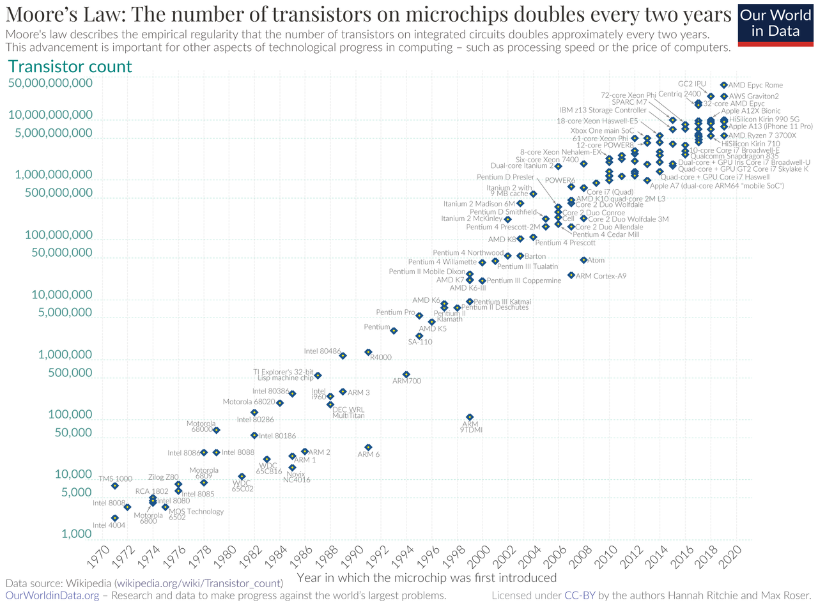
Niet de techniek, maar de kosten en infra zorgen voor de snelle technische innovatie:
Lagere kosten
Betaalbare & grotere computerkracht
Betaalbare & betere sensoren
Goedkoop geheugen
Digitalisering
Betere infrastructuur
Connectiviteit
Bandbreedte
Data
Publieke gegevens
Internet of Things
De opkomst van AI
Machine learning
Deep learning
Notes:
Toch is er een exponentiéle transitie gaande!

Slide 9
De ultieme integratie van technologie, wanneer we die inzetten in maatschappij:
Robotisering
Wat als we dit allemaal samenbrengen?

Slide 10
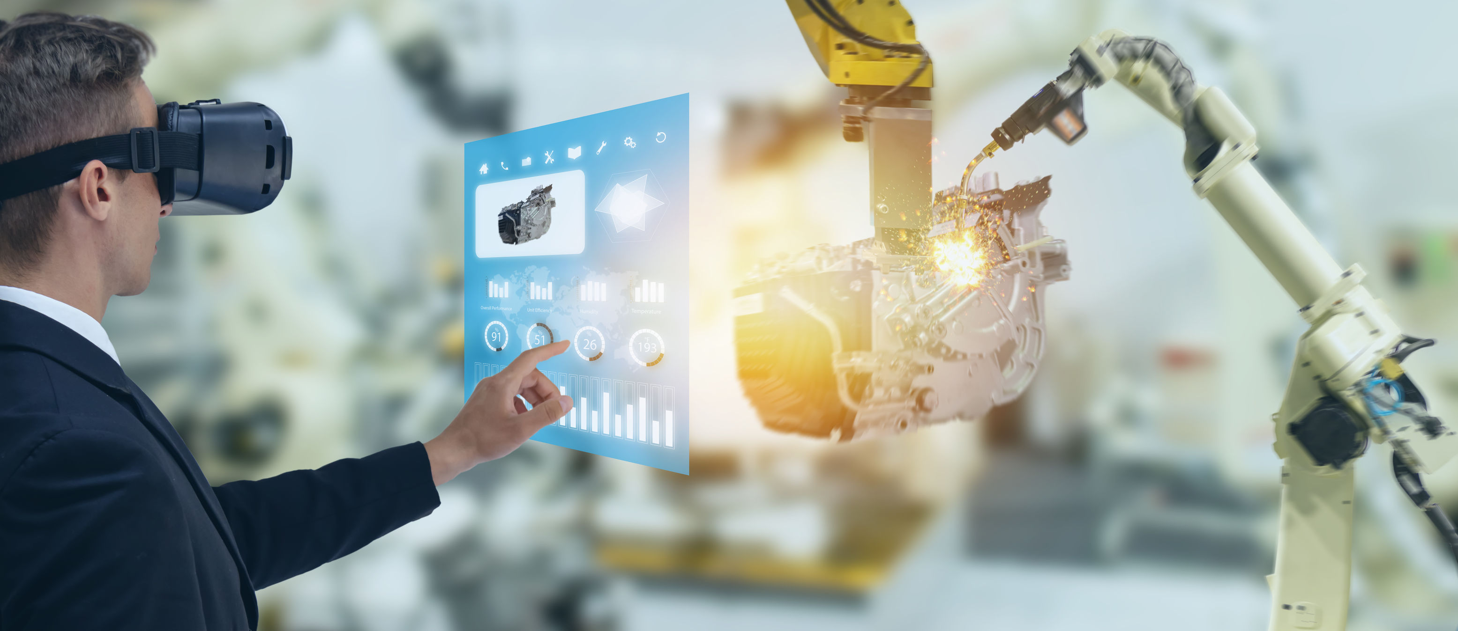
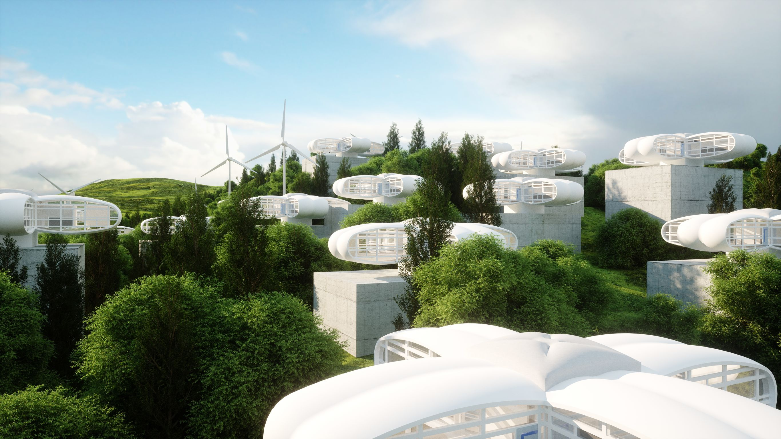
Phases of robotization
Phase 1: Efficiency and Economies of Scale through ‘hard’ automization for mass production
Phase 2: Taking over repetitive / predictable work (dull, dirty or dangerous)
Phase 3: Taking over unpredictable work Flexible automization through high-tech sensoring & AI. Robotized work will become cheaper.
Phase 4: A fundamental new perspective on industry AND society. A ‘cyber-physical world’ in which new processes become possible
We are +/- here

Slide 11
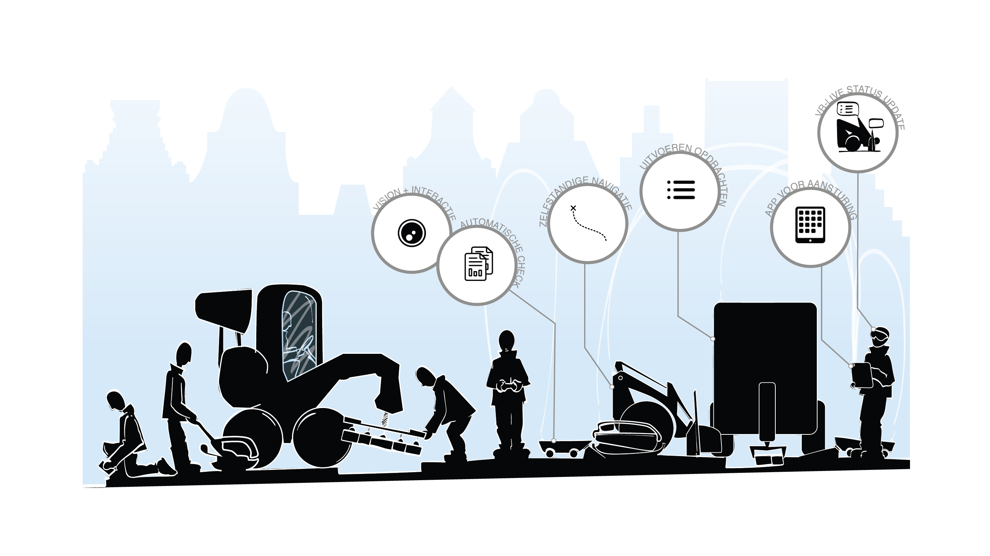
Het werk gaat veranderen!
Voorbeeld: De evolutie van de stratenmaker
© 2021 C-Boost B.V.

Slide 12
Digital Twin
Notes:
https://www.youtube.com/watch?v=iVS-AuSjpOQ

Slide 13
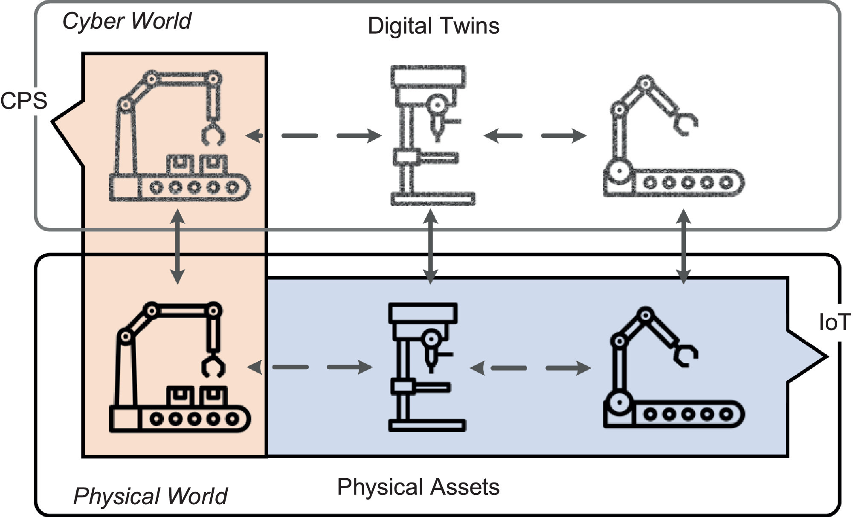
Van Digital Twin naar Cyber Physical System
Wanneer de Digital Twin ook output gaat leveren aan de Fysieke wereld hebben we een Cyber-Physical System!

Slide 14
Robotization project examples
Cobots
AGVs
Object Recognition
Computer Vision
Strategy & Roadmaps
AI Development & personalisation
Custom Engineering
Systems Engineering
3D Modelling & Simulation
Quickscans & Consultancy

Slide 15
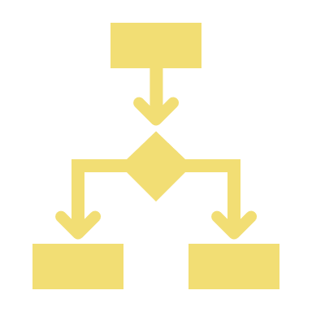
Wat is nodig? System Engineering
Validation
Verification
Acceptance
Embedded Software
Requirements
Integration
Human
factors
Front & backend
Project
leadership
Project Management
Design
UI/UX
Control
Systems
Human-centered
Engineering
Actuators
Sensors
Security
AI
Tech-centered
Engineering
Law and regulations
!
Ethics
Risk man-
agement
Advisory

Slide 16
Multidisciplinary teams
Project Management
Human-centered
Engineering
Tech-centered
Engineering
Advisory

Slide 17
Cyberphysical Change Boost required!
Daarvoor moeten we innoveren om techniek in te zetten voor de komende transities door:
Samenwerken
Standaardiseren
Waarde laten zien
Processen digitaliseren
Systeemdenken
Interdisciplinaire inzet
Creativiteit stimuleren
Durven te veranderen
De grootste uitdagingen
Notes:
Vraag: wat Hebben we nodig voor de transitie?

Slide 18
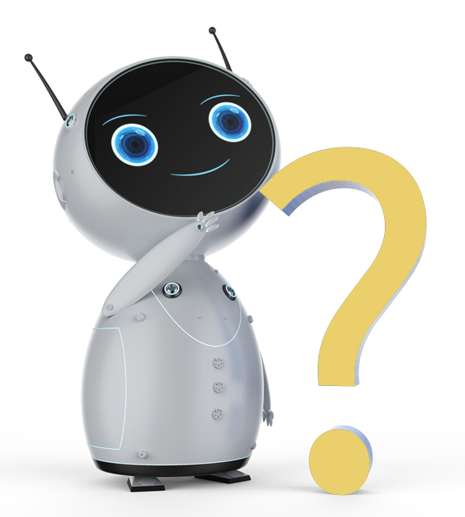
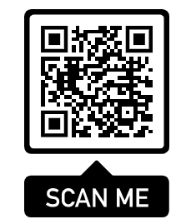

Slide 19
Cboost product family
Engineering Boost
Engineering teams
Consultants
Custom engineering
Inspiration boost
Strategy & Roadmaps
Animation & Vision
Workshops
Transition Boost
Quickscans & Research
Processes & Skills
Change & job transition
Product boost
Off-the-shelf products
Standardized modules
Robots: Cobots, AGVs

